Slide 1
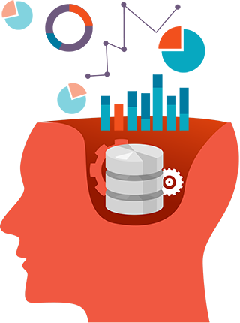
RESEARCH PAPER 1
A FEW THINGS TO KNOW ABOUT MACHINE LEARNING.

Slide 2
SUBTOPICS:
LEARNING= REPRESENTATION + EVALUATION + OPTIMIZATION
IT’S GENERALIZATION THAT COUNTS
DATA ALONE IS NOT ENOUGH
OVERFITTING HAS MANY FACES
INTUITION FAILS IN HIGH DIMENSIONS
THEORETICAL GUARANTEES ARE NOT WHAT THEY SAY
FEATURE ENGINEERING IS THE KEY
MORE DATA BEATS A CLEVERER ALGORITHM
LEARN MANY MODELS, NOT JUST ONE
SIMPLICITY DOES NOT IMPLY ACCURACY
REPRESENTABLE DOES NOT IMPLY LEARNABLE
CORRELATION DOES NOT IMPLY CAUSATION

Slide 3
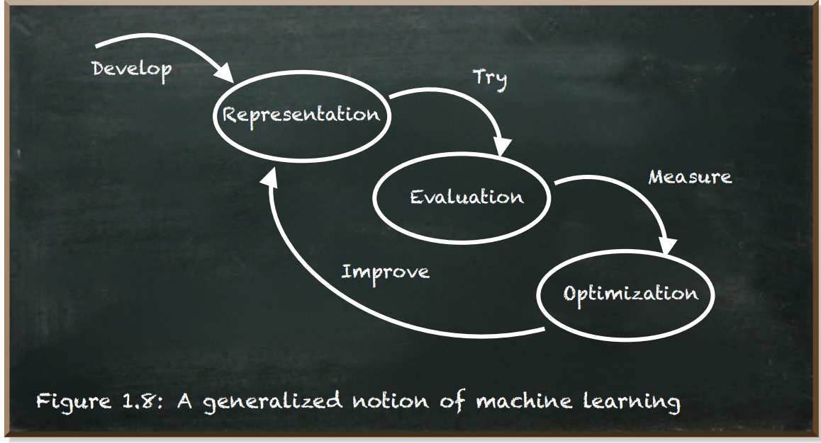
COMPONENTS OF MACHINE LEARNING

Slide 4

REPRESENTATION
WHAT MODEL DO YOU CHOOSE TO REPRESENT THE DATA?
FIND THE MAPPING (I.E., FUNCTION) THAT RELATES THE INPUT TO THE OUTPUT
A CLASSIFIER MUST BE REPRESENTED IN SOME FORMAL LANGUAGE THAT THE COMPUTER CAN HANDLE
THE FUNCTION IS CHOSEN FROM A HYPOTHESIS SPACE, A SET OF ALL CLASSIFIERS THAT IT CAN POSSIBLY LEARN
EXAMPLE: IN THE CASE OF LINEAR REGRESSION, THE REPRESENTATION OF OUR MODEL IS A LINEAR FUNCTION. REGARDLESS OF WHAT WEIGHTS W WE CHOOSE, OUR MODEL WILL BE A LINEAR FUNCTION

Slide 5

EVALUATION
AN EVALUATION OR OBJECTIVE FUNCTION (OR COST FUNCTION) IS NEEDED TO DISTINGUISH GOOD CLASSIFIERS FROM BAD ONES.
EXAMPLE: IN THE CASE OF LEAST-SQUARES LINEAR REGRESSION, THE COST FUNCTION WAS MEAN-SQUARED ERROR COST FUNCTION.
EXAMPLE: WE HAVE TO CLASSIFY A DISEASE AS INCURABLE (POSITIVE OR 1) OR CURABLE (NEGATIVE OR 0) WHERE CHANCES OF INCURABLE DISEASE IS VERY LOW. WE WANT TO AVOID REPORTING ‘INCURABLE’ FOR A CURABLE DISEASE. WHAT WOULD BE THE BEST EVALUATION METRIC?
Answer: Precision. We need to reduce false positives.
Precison= true positives/(true positives+false positives)

Slide 6
optimisation
WHAT IS OUR PROCESS FOR FINDING THE GOOD MODELS AMONG ALL THE POSSIBLE MODELS?
A (SOLVER) FUNCTION THAT SEEKS THE OPTIMAL VALUES OF THE LOSS FUNCTION. IT ESTIMATES THE PARAMETERS AND SELECTS THOSE VALUES THAT RESULT IN THE LOWEST ERROR (MINIMUM) OR HIGHEST REWARD VALUE (MAXIMUM).
EXAMPLE
GRADIENT DESCENT IS AN OPTIMIZATION ALGORITHM THAT CAN BE USED FOR FINDING THE OPTIMAL MODEL FOR LEAST-SQUARES LINEAR REGRESSION.
.

Slide 7
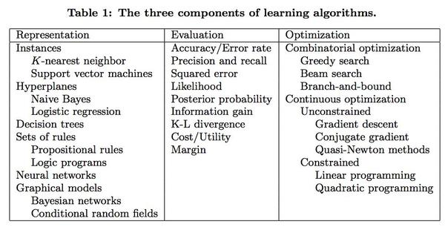
EXAMPLES OF THE THREE COMPONENTS OF ML

Slide 8

RELATION BETWEEN REPRESENTATION, EVALUATION AND OPTIMIZATION
Choosing any one component of the machine learning algorithm (say the optimization method) depends on our choices for the other components.
For example, gradient descent can only be applied if the cost function is differentiable, i.e. it is a smooth function (since we need to calculate the gradients).
Not all combinations of one component from each column of the table make equal sense. For example, discrete representations naturally go with combinatorial optimization and continuous ones with continuous optimization.

Slide 9

GENERALISATION
THE FUNDAMENTAL GOAL OF MACHINE LEARNING IS TO GENERALIZE BEYOND THE EXAMPLES IN THE TRAINING SET.
THE MOST COMMON MISTAKE AMONG MACHINE LEARNING BEGINNERS IS TO TEST ON THE TRAINING DATA
MAKE SURE TO SET SOME OF THE DATA ASIDE FROM THE BEGINNING, AND ONLY USE IT TO TEST YOUR CHOSEN CLASSIFIER AT THE VERY END
CONTAMINATION OF YOUR CLASSIFIER BY TEST DATA CAN OCCUR IN INSIDIOUS WAYS, FOR EXAMPLE, IF YOU USE TEST DATA TO TUNE PARAMETERS AND DO A LOT OF TUNING.

Slide 10

DATA DIVERSITY
TRAINING A GENERALIZED MACHINE LEARNING MODEL MEANS, IN GENERAL, IT WORKS FOR ALL SUBSETS OF UNSEEN DATA.
EXAMPLE: MODEL TO CLASSIFY BETWEEN DOGS AND CATS

Slide 11
HOW TO COUNTER THE REDUCTION IN TRAINING DATA?
This can be mitigated by doing cross-validation
LET'S DISCUSS AND ANALYZE
GENERALIZATION BEING THE GOAL HAS AN INTERESTING CONSEQUENCE FOR MACHINE LEARNING
The objective function is only a proxy for the true goal and we
may not need to fully optimize it.
IS DATA DIVERSITY ENOUGH TO GET A PROPER
GENERALISED MODEL?
No, data alone is not enough

Slide 12
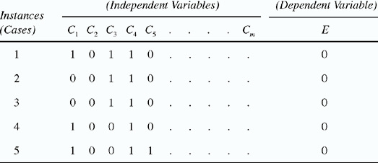
Data alone isn't enough for a model to perform well
Generalization being the goal has an- other major consequence: Data alone is not enough, no matter how much of it you have.

Slide 13
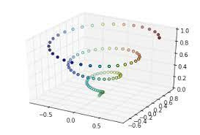
Fortunately, real-world functions that we want to learn doesn't come from a set of all possible functions, as the dimension of input space increases, the number of examples that seemed quite big for lower dimension input space tends to be minuscule for higher dimension input space.

Slide 14
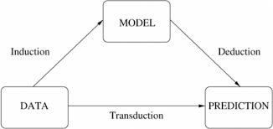
Induction and Deduction
Induction and deduction are two methods that take input knowledge and convert it into output knowledge.

Slide 15
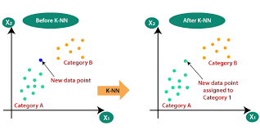
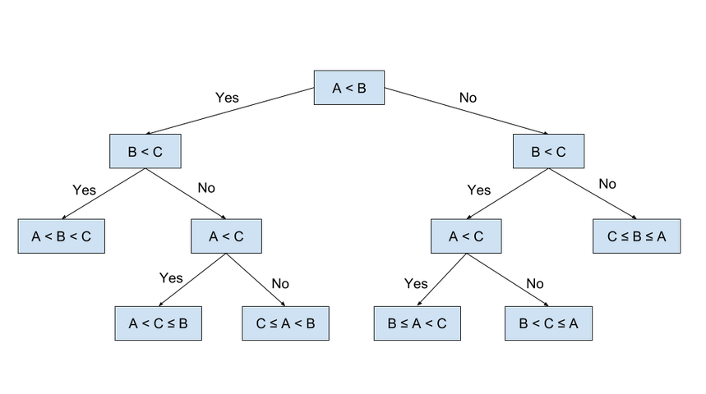
Selecting a model based on the knowledge that can be inferred from a model
Decision Tree model
KNN model
instance based learning
IF...THEN condition
A graphical model or probabilistic graphical model (PGM) is a probabilistic model for which a graph expresses the conditional dependence structure between random variables.

Slide 16
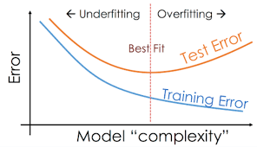
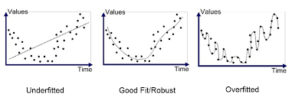
Different faces of overfitting
Strong false assumptions are better than weak true ones

Slide 17
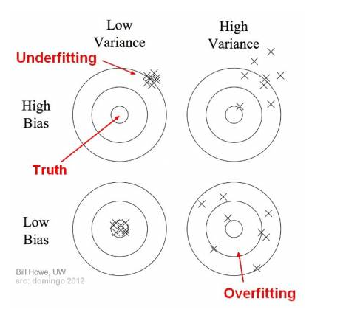
Bias and Variance

Slide 18
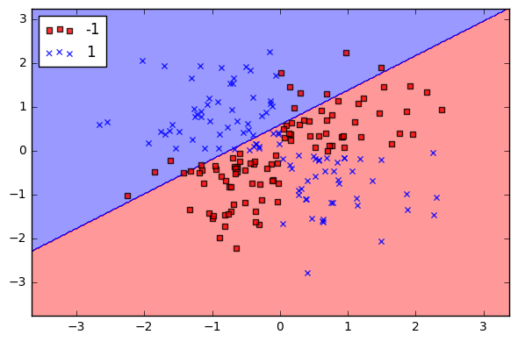
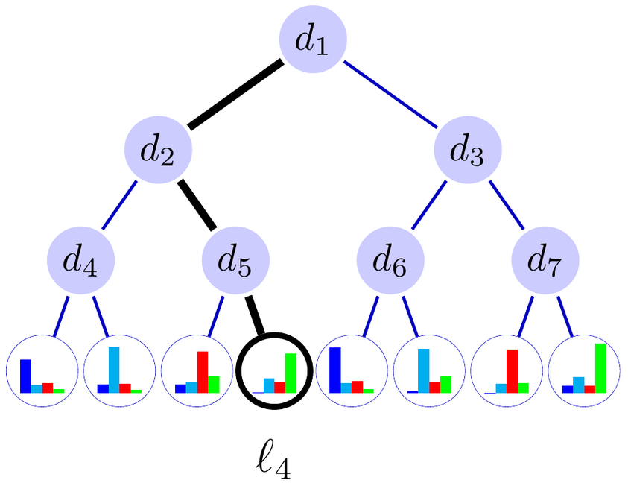
High Bias
High Variance

Slide 19
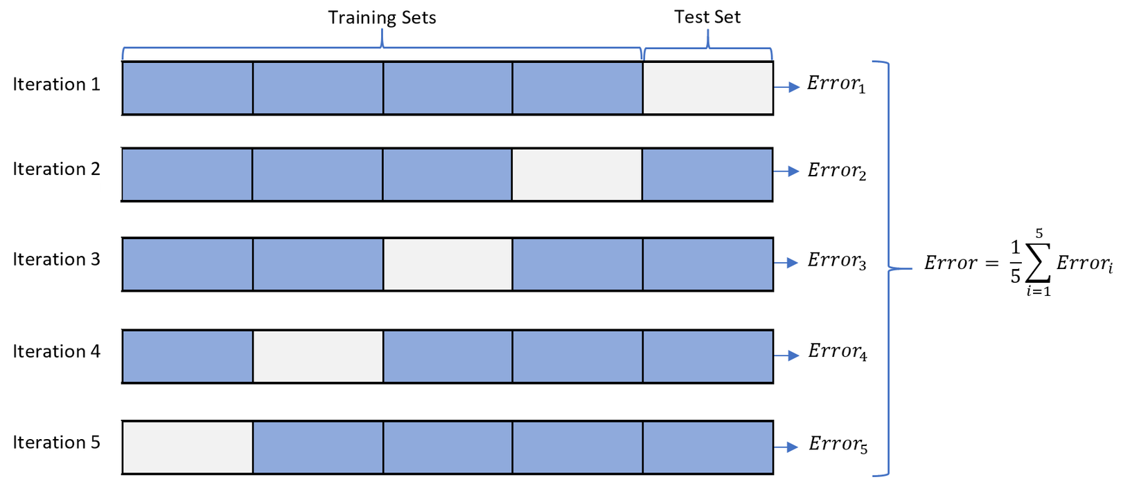
Cross-Validation
A misconception :-
A common misconception about overfitting is that it is caused by noise

Slide 20
Multiple testing problem
The problem of multiple testing is closely related to overfitting. Standard statistical tests assume that only one hypothesis is being tested, but modern learners can easily test millions before they are done.
Two ways to deal with it :-
Correcting the significance tests to take the number of hypotheses into account
2. Control the fraction of falsely accepted non-null hypotheses, known as the false discovery rate.

Slide 21

INTUITION FAILS IN HIGH DIMENSIONS
Curse of Dimensionality
Generalizing correctly becomes exponentially harder as the dimensionality of examples grows.
Assume a training set with moderate dimension of 100 and a huge set of trillion of examples.
This trillions of training example will cover only a very small fraction of input space.
Input Space – Total Number of possible inputs.
Here, 2^(100) assuming features to be binary.
(12)
Fraction :- 10
10
= 0
(30)

Slide 22
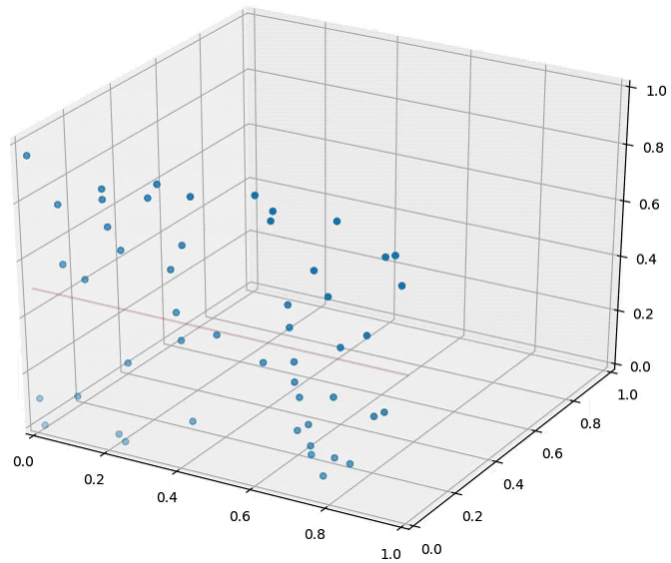
The similarity based reasoning that machine learning algorithms depend on (explicitly or implicitly) breaks down in high dimensions
Not all features are relevant
Even if they are relevant Increasing dimension increases possible nearest neighbor until the choice become completely random
Distance between nearest points
= 1
Distance between farthest points

Slide 23
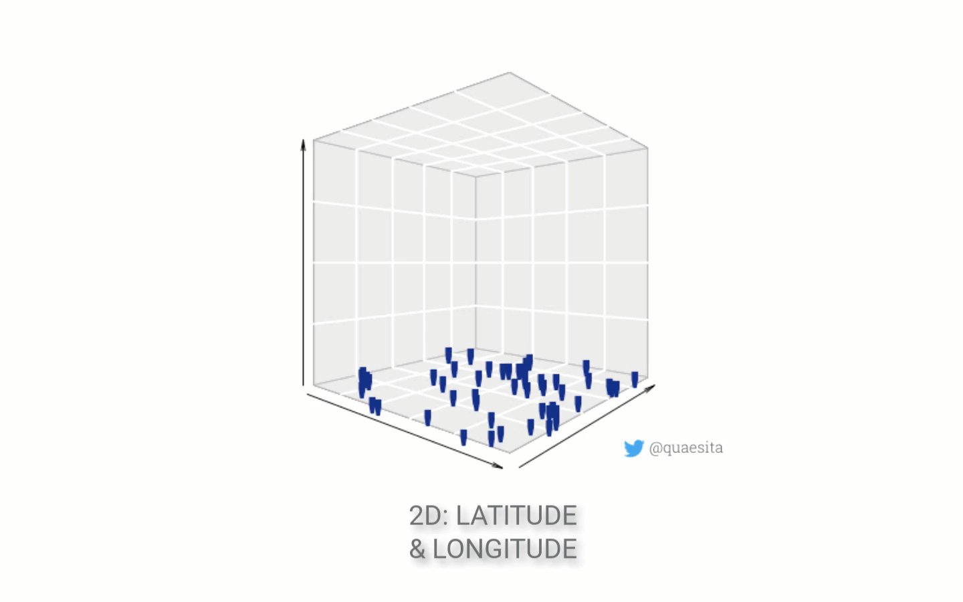

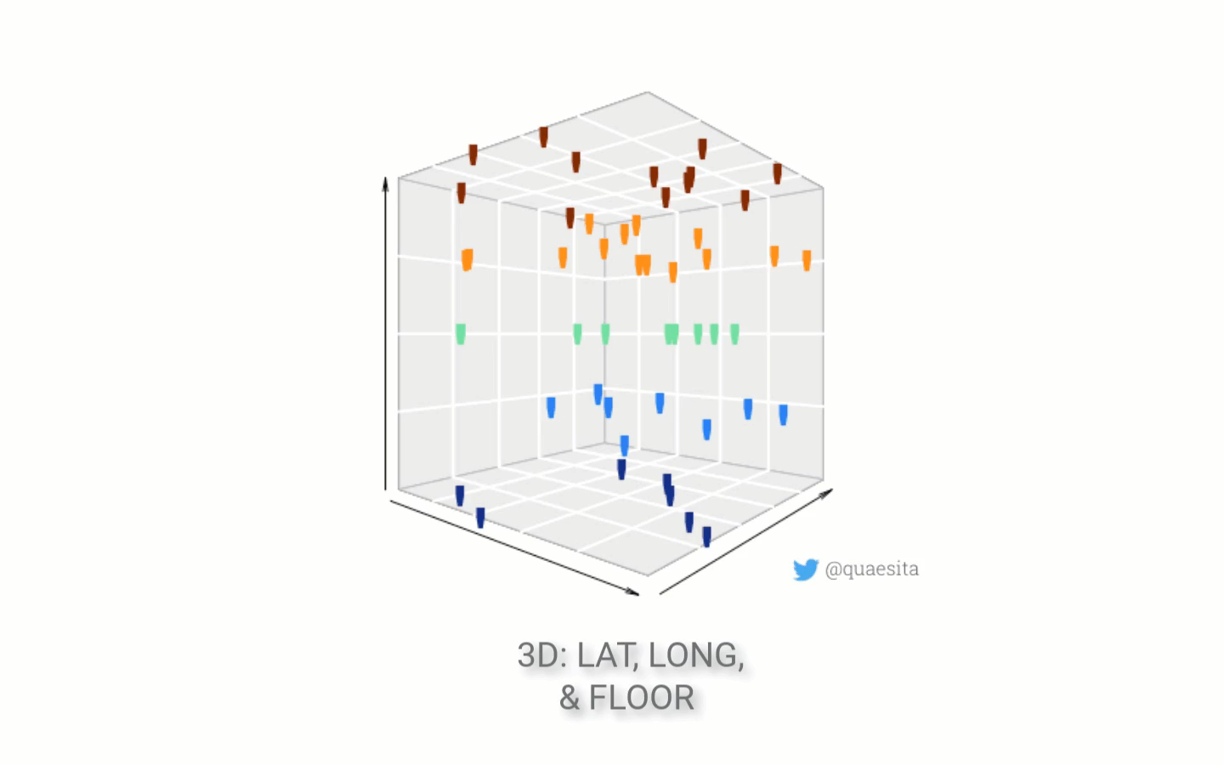
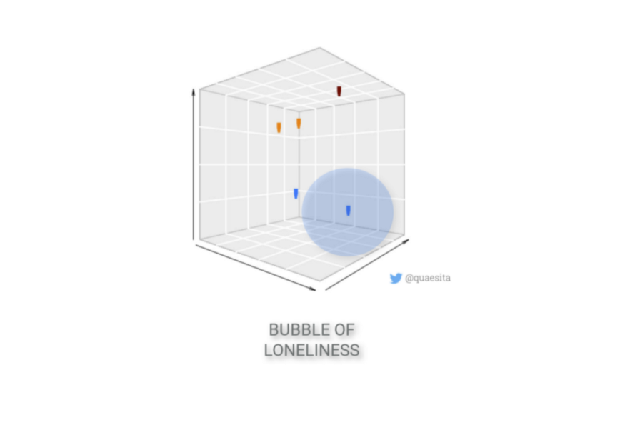

Slide 24
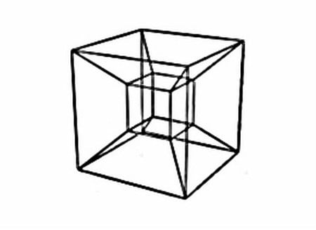
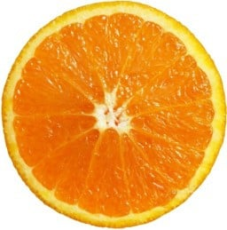

Our Intuitions from 3D world fails
OUR INTUITIONS FROM 3D WORLD FAILS
Building classifier in 3d is easy as we can visualize it well.

Slide 25
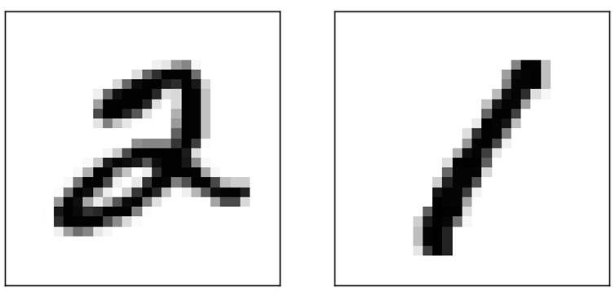
“Blessing of Non-Uniformity”
DO YOU THINK MORE FEATURES DOES NO HARM ???
But they does
Data is concentrated on or near a lower dimensional manifold
Learners can implicitly take advantage of this lower effective dimension, or algorithms for explicitly reducing the dimensionality can be used

Slide 26
Theoretical guarantees are not what they seem
Theorems are stated in a mathematically strict sense. Extrapolating from these theorems to make decisions in practice is prone to errors, and one needs to be very careful.
Theory says it is possible, but in practice it is not always such a good idea
The Universality theorem asserts that neural networks can compute any computable function. Moreover, even a NN with only one hidden layer can accomplish this task.

Slide 27

A NN is capable of representing a computable function,
how to find such a NN in the hypothesis space?
Learning = Representation + Evaluation + Optimization. This theorem only talks about the representation, not the optimization.
In practice, a single layered NN would take exponentially more neurons, and exponentially more data
The theorem should NOT be read as NNs being better than other machine learning algorithms.
The other algorithms will still continue to perform better than NN’s in terms of overfitting, computational efficiency, amount of data required etc. for certain problems

Slide 28
THEORY IS TOO CONSERVATIVE, BUT IN PRACTICE IT WORKS PRETTY WELL.
There are a number of theoretical bounds about number of training samples given the number of parameters in a model required for good generalization.
A lot of these theoretical bounds are extremely loose. In practice requirements for total amount of data is usually less restrictive that theoretical bounds suggest.

Slide 29
Similar theorems exist for predicting convergence time of various algorithm
For the perceptron algorithm, theoretical bounds saying convergence is guaranteed in number of iterations = exponential in dimensionality of input space.
However, in the average case the algorithm is relatively efficient and only needs polynomial time

Slide 30
Be careful about the theoretical meaning
According to the no free lunch theorem, any two classifiers are equivalent when their performance is averaged across all possible problems. This means that if classifier A outperforms classifier B for some problems, then classifier B must outperform classifier A over other problems.
'Algorithm is fixed first'
'All possible problems'

Slide 31
ALGORITHM IS FIXED FIRST
'All possible problems'
Imagine a problem where we need to predict the gender of a person, male / female, based on 10 binary features. 10-dimensional input maps to a one-dimensional output
There are 2^(10) possible inputs, and each problem is defined as the output produced for each input. Since each output has 2 possible values, we have 2^(2^10) possible problems

Slide 32

There is no correlation among features, and there is no independence.
In realistic problems, dimensions usually have a semantic meaning
Even if that is not true for an individual dimension, in realistic problems, a small set of the features is enough to provide evidence towards output being 1 or 0 in isolation, i.e. regardless of the value of the other features. Almost all problems in the real-world have this property. Hence, it does not make much sense to consider all possible problems in the mathematical sense.
Notes:
means that the dimension is often directly correlated with the output.

Slide 33

Words of Advice
Although theoretical guarantees can be used for guiding research directions and making decisions in practice, in machine learning there is often a wide gap between practice and theory. It is important to understand this gap, and be cautious to not extrapolate a theorems results in order to use it for decision making in practice.

Slide 34
WHAT MATTERS
Parameters that matter to give a certain outcome of a hypothesis are called features.
CHALLENGES FACED
FEATURE ENGINEERING
Datasets with only single feature are easier to learn, but more complex ones pose challenges:
Time-consuming
Hard to find patterns
TAKES LOTS OF EFFORT
Most effort in building a model goes into deciding which parameters matter.
It is a display of intution, creativity and 'Black Art'

Slide 35
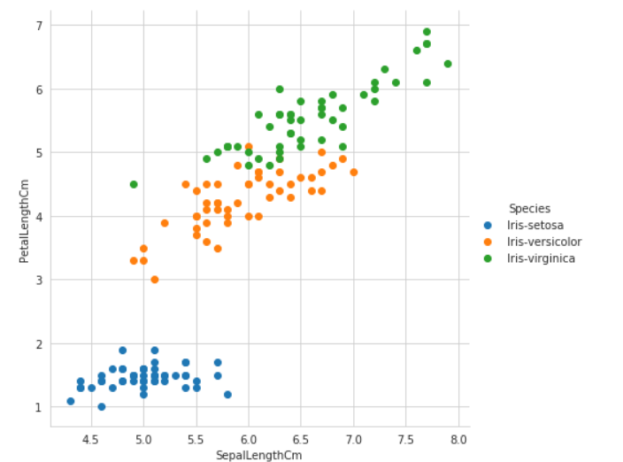
How does a model percieve features
EXAMPLE: IRIS DATASET
Here the input is "Petal Length" and "Sepal Length".
The aim is to classify different Iris flowers into different species, "Setosa", "Versicolour" and "Virginica".
We have only two parameters and luckily the categories are distinctively categorized according to these parameters.
To produce output, the model "encodes" the Target as:
SETOSA - (1)
VERSICOLOR - (0)
VIRGINICA - (-1)
For a range of "Petal_length" AND "Sepal_length", the flower is categorized into (1),(0) and (-1)

Slide 36

WHY IS FEATURE ENGINEERING HARD
Feature Engineering is a lengthy and time taking process because it is a Iterative process (hit and trail method).
It is a very Domain specific skill. Requires knowledge of the dataset.
One of the "Holy Grails" is to make Feature Selection as automated. However, this requires another machine learning algoritm.
Certain features in a dataset may seem irrelavent indivisually but are relevant in combination with other features.
Not all features have equal importance : their importance varies.
Using of excessive features is time consuming and can lead to over-fitting (Curse of Dimesionality).

Slide 37
WHEN YOU HAVE CHOSEN BEST OF FEATURES AND ACCURACY IS STILL LOW...
OPTIMIZATION
MORE DATA IS BETTER THAN CLEVER ALGORITHM
IMPROVE
ALGORITHM
COLLECT
MORE DATA
Reduces the Curse of Dimensionality.
Gives more specific output.
Requires less amounts of data.
Lets the data do heavy lifting.
It avoids overfitting.
Can work with simple classifiers too..

Slide 38
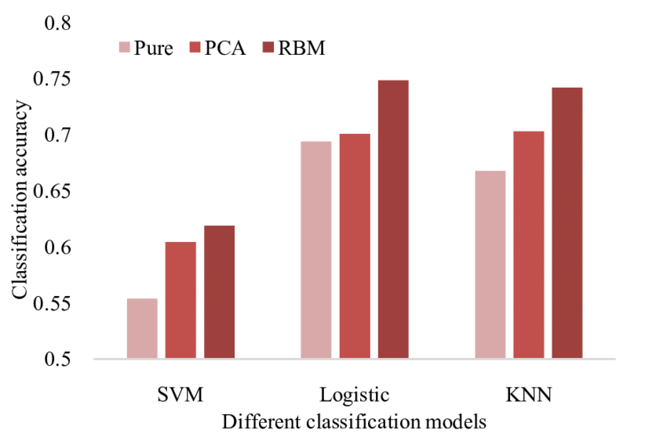
TYPES OF LEARNERS
LEARNERS
FIXED SIZE
NON-PARAMETERIZED
Can learn only fixed amount of data.
Example: Linear Classifier.
Representation can grow with data.
Caught up by the Cursre of dimensionality.
Example: Descision Trees, Naives Bayes Algoritm.

Slide 39
Simple algorithm with more data have higher payoff....
Complex learners
Complex Classifiers
-Take advantage of huge amounts of data.
-Can learn any function hence has hard time chosing an appropriate one.
-Uses unnecessary parameters as the given amount of data is huge.
-Experiences the curse of dimensionality.
- Requires too much memory.
-Reqiures too much time to learn.
-Complex algorithms may give accurate resuts but are highly unstable. Their output differs with even small change in input.
- Clever algoritm cause overfitting because they are tailor-made to fit data.
-Clever algorithms have too many knobs to turn and their internal workings are unknown to the interpreter, hence hard to chose which knobs to turn.
-Complex classiers take too long to learn.
- Human effort/errors are reduced by using simpler classifiers.
-

Slide 40

LEARN MANY MODELS, NOT JUST ON
ENSEMBLE

Slide 41
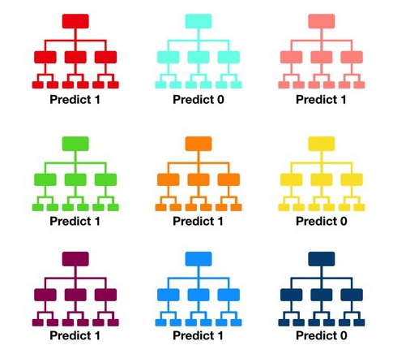
WHY ENSEMBLE??
In Ensemble method several weak learners are correctly combined
to form more accurate and robust model.
Random forest classifier
Combining uncorrelated model is the key

Slide 42
10 BALLS IN BOWL. IF VALUE IS LESS THAN OR EQUAL TO 4 THEN I WIN ELSE YOU WIN. WHAT WOULD YOU PICK?
1
2
and so on
Game 1 — play 100 times, betting $1 each time.
Game 2— play 10 times, betting $10 each time.
Game 3— play one time, betting $100.

Slide 43



LOOK AT THE EXAMPLES
OLDMEAD SECONDARY SCHOOL
BOOSTING
STACKING
BAGGING
Training examples have weights, and these are varied so that each new classifier fo?cuses on the examples the previous ones tended to get wrong.
ex: XGBoost
The outputs of individual classifiers become the inputs of a “higher-level” learner that figures out how best to combine them.
Random variations of the training set by resampling, learn a classifier on each, and combine the results by voting.
ex: Randomforest
SCIENCE CLASS

Slide 44
model 1
final model
Input
model 2
input 2
output
model 3

Slide 45
SIMPLICITY DOES NOT IMPLY ACCURACY

Slide 46
OLDMEAD SECONDARY SCHOOL
TWO MODEL SAME ACCURACY --> WHAT MODEL TO CHOOSE?????????
ADVANTAGE OF SIMPLE OVER COMPLEX MODEL:
PREVENTS OVERFITTING
INTERPRETABILITY
COMPUTATIONAL EFFICIENCY
SCIENCE CLASS

Slide 47
Simple model!!!

Slide 48
Truth is we have to find the sweet spot
in trade-off of simpler vs complex model
We can prevent overfitting using regularization dropout etc..
Computational efficiency affordability.
The conclusion is that simpler hypotheses should be preferred because simplicity is a virtue in its own right, not because of a hypothetical connection with accuracy. And
should not throw away complex model until proven false.

Slide 49
REPRESENTABLE DOES NOT IMPLY LEARNABLE

Slide 50
Theoretical claims of universal approximation:
“Every function can be represented, or approximated arbitrarily closely”

Slide 51
Given finite data, time and memory, standard learners can learn only a tiny subset of all possible functions, and these subsets are different for learners with different representations.
Thats also one reason to look out for ensemble models.
OLDMEAD SECONDARY SCHOOL
SCIENCE CLASS

Slide 52
Assume we need "n" leaves for a decision tree to approximate to an arbitrary function and we have "m" training examples.
3 possiblities:
n==m
n<m
n>m

Slide 53
CORRELATION DOES NOT IMPLY CAUSATION

Slide 54
BASICS:
OLDMEAD SECONDARY SCHOOL
Correlation is a statistical technique which tells us how strongly the pair of variables are linearly related and change together
Causation means any change in the value of one variable will cause a change in the value of another variable, which means one variable makes other to happen. It is also referred as cause and effect.
SCIENCE CLASS

Slide 55
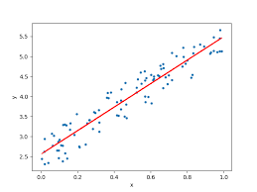
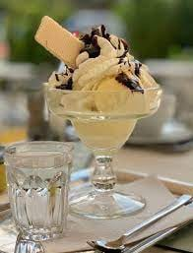
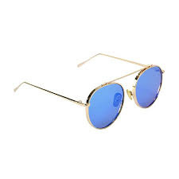
EXAMPLE
Correlation between Ice cream sales and sunglasses sold.

Slide 56


Slide 57
THANK YOU

